Slide 1
Home BP Monitoring in Highland
Joanna Gilliatt
Technology Enabled Care (TEC)
NHS Highland

Slide 2
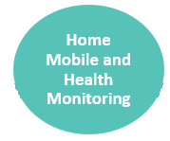
Background
NHS Highland’s TEC Team – established July 2015
Funded by the Scottish Govt’s TEC Programme 2015-18
TEC = Technology Enabled Care
Telecare
Video-conferencing – now Near Me
Telehealth – home and mobile health monitoring
Aims of the programme:
Support people to live longer, healthier lives at home
Prevention, early intervention & self-management
Improve access to services

Slide 3
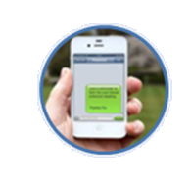
Florence – Simple Telehealth
Automated text messaging service
Uses the patient’s own mobile phone
Set up to send a programme of text messages
Interactive - patient can send in readings and get advice back
Used for
Tips – advice – reinforcement – support – monitoring: symptoms & readings
Asthma – COPD – Heart Failure – IBS – chronic pain – and many more
Target – 2,000 patients; achieved by April’18

Slide 4
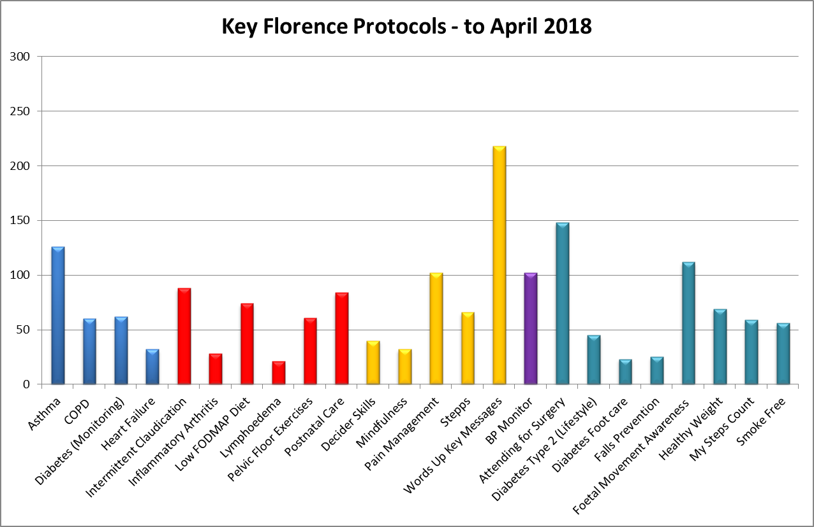

Slide 5
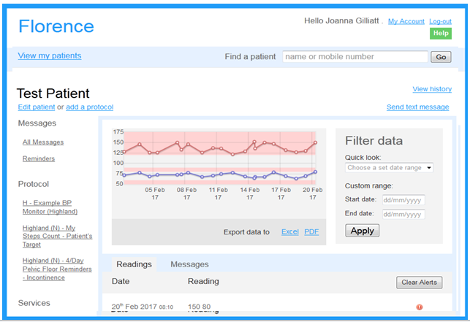
Use of Florence for Home BP Monitoring
Introduced – June 2017
Mainly used for diagnosis
Florence (or Flo) asks for readings twice a day
Patient sends the reading by text
Flo gives advice if needed
Clinician reviews readings

Slide 6
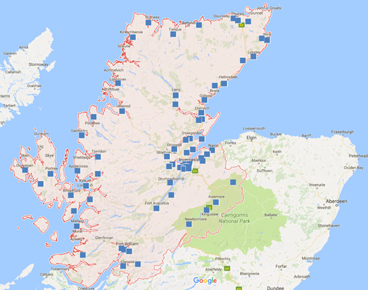
Scale-Up BP – 2019 to 2021
New 2 year TEC Programme – started April 2019
New targets:
2,000 patients
50% of GP practices
BP monitoring used for:
Diagnosis (daily readings)
Medication titration (twice weekly)
Long-term monitoring (monthly)
Automated reports go into primary care systems

Slide 7
Scale-Up BP – Why?
Reduction in GP surgery appointments
Reduced patient travel & time off work
Increased personal responsibility
Speedier, more accurate diagnosis
No more white coat syndrome
No need for 24 hour ambulatory monitor
Accurate titration of medication
Reduced use of unnecessary medication
Improved BP control
Reduction in heart disease and strokes

Slide 8
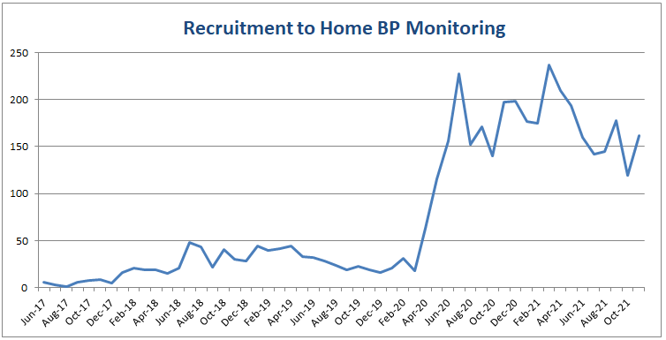
Uptake of Florence for BP monitoring
GP practices trained to use Florence:
March’20 – 14
Present – 51

Slide 9
Florence – Pros & Cons
What’s good
Simple to use
Simple to create new protocols
Free for patients to use
What’s not so good
Patient needs a mobile phone and to be able to text
No option for the patient to see a graph of their own readings
Only simple protocols are possible
Expensive – 8p per text message x 46,000 texts = £3,680 per month

Slide 10
Emergency Scottish Govt procurement – mid-2020
Motivated by the need to monitor Covid symptoms
3 +1 +1 year contract now signed with Inhealthcare
Inhealthcare RHM services now developed (or in development) for:
Asthma
BP monitoring
COPD
Covid
Heart failure
Chronic pain
IBS
Many more to come

Slide 11
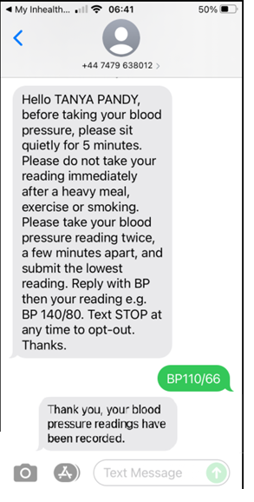
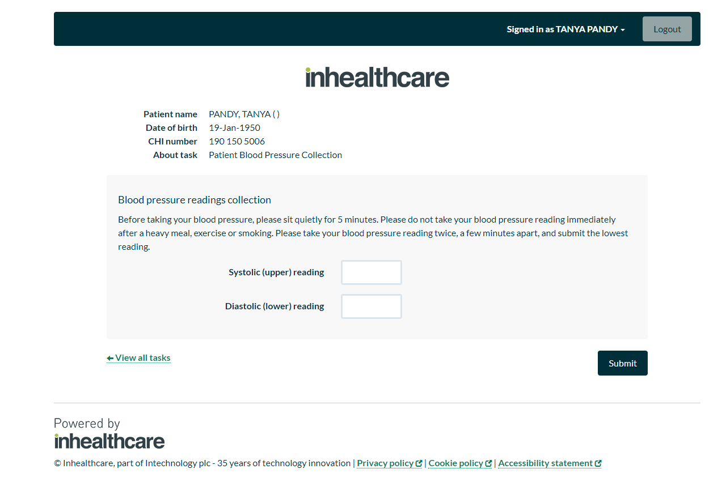
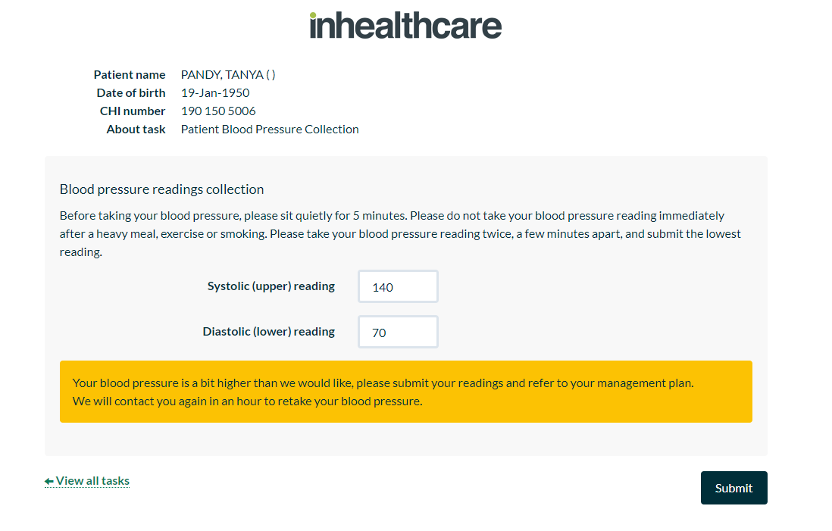
– Pros & Cons
What’s good
4 channels:
Text messaging
Automated phone call
Web portal
App
Will reach a wider range of patients

Slide 12
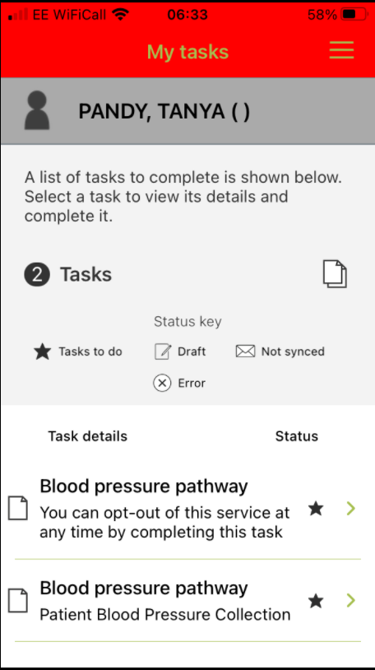
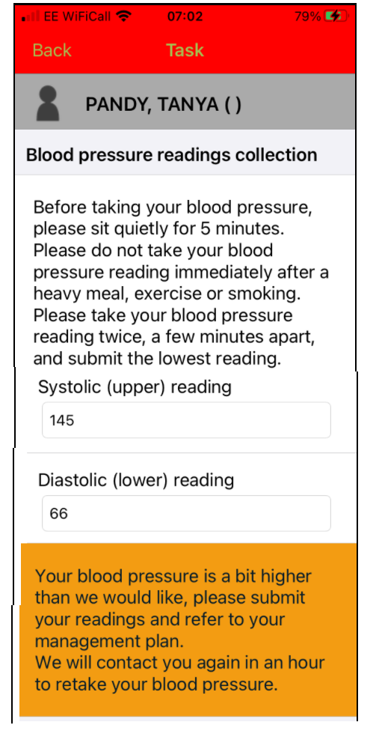
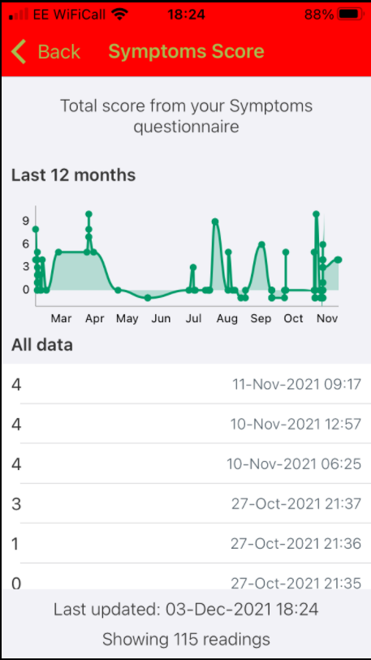
– Pros & Cons
What’s good
App
The patient can see a list & graph of the readings they submit

Slide 13
– Pros & Cons
What else is good
Procured by the Scottish Govt. with all costs covered nationally
Sophistication – much more complex services are possible
Possible to develop new services – not relying on the supplier
What’s not so good
Developing new services is complex and time consuming

Slide 14
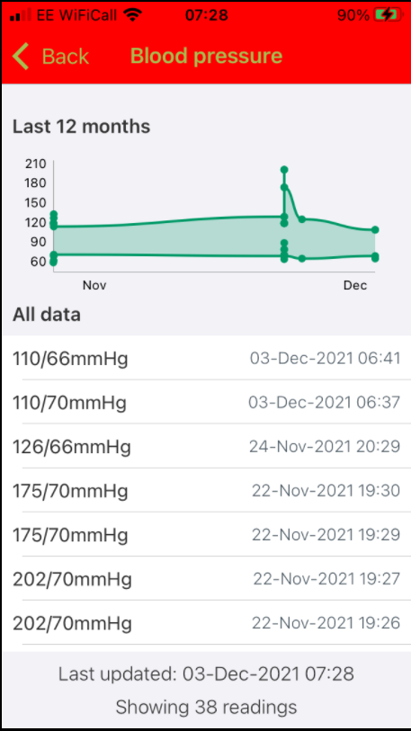
– Home BP Monitoring
New BP service has been developed
Complex on the inside
Simple on the outside
Easier for primary care to use
Will reach a wider range of patients
Patients have a choice of channel
Patients can track their own readings

Slide 15
– Home BP Monitoring
Current plans:
Final stages of testing – December 2021
Test of change with a small number of GP practices – January 2022
Gradual rollout to all interested GP practices in Highland
Engagement/discussion
Training
Transfer of patients
Ongoing support
Florence will go out of use in Highland – by August 2022

Slide 16
Any Questions?
joanna.gilliatt@nhs.scot

