Slide 1
The what, where and why of the pelvic floor?
Lynne Tait
Pelvic health specialist physiotherapist

Slide 2
Taboo?
Stats suggest that around 1 in 3 women leak urine, around 50% have pelvic organ prolapse after vaginal delivery and around 1 in 10 have anal incontinence. Sadly, some people feel too embarrassed to seek help (so numbers of those suffering are likely higher). Some may not know that help is available. These problems are common but NOT normal. We should not be putting up with them. Spread the word that help is out there!
The latest draft NICE guidelines (2021) for pelvic floor dysfunction suggest that we should be taught about pelvic floor muscles in school…wouldn’t this be great??!

Slide 3
What is the pelvic floor?
Layers of muscles that sit inside our pelvis
They sit underneath the bladder, womb (if you have one) and bowel.
Sometimes described as a supportive “sling” (they are more like a bowl shape or like a pair of cupped hands)
Women and men have pelvic floor muscles.
As with any other muscles in the body – they can get weak however we can also improve their function through exercises and lifestyle changes. It is NEVER too late to start!

Slide 4
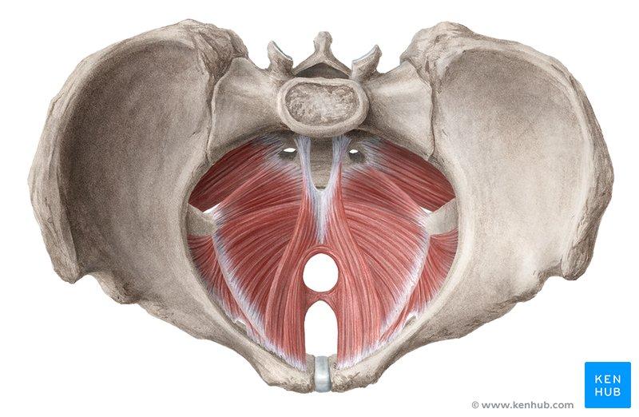

Slide 5
What do these muscles do?
Supports the pelvic organs (bladder, womb and bowel).
Keeps us continent (dry).
Important role in sexual function…a good functioning pelvic floor can help enhance orgasms.
Makes up part of our “core” of muscles which are important in terms of our posture, back care and overall function.

Slide 6
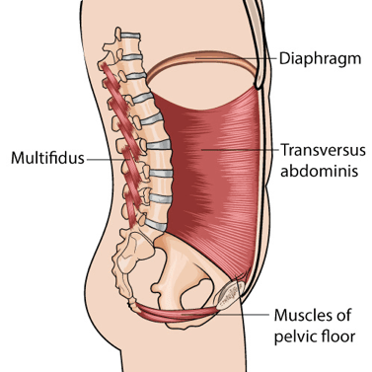
Our “Core”

Slide 7
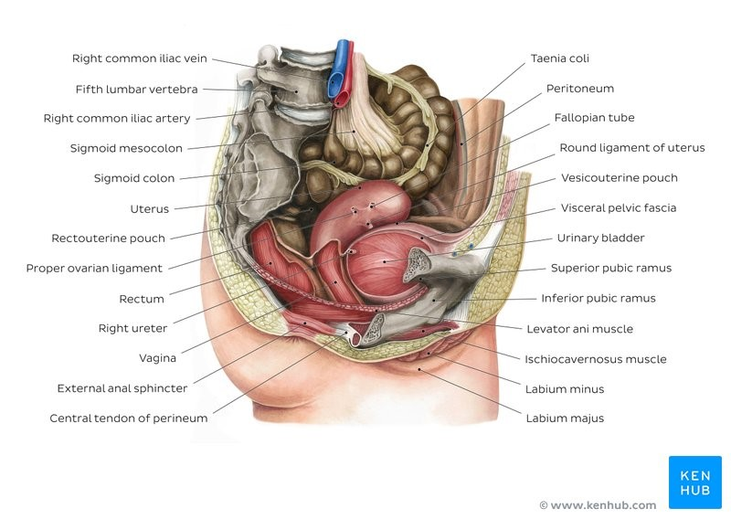

Slide 8
What can go wrong if the pelvic floor isn’t working properly?
Leaking (pee, poo, gas or a combination)
Prolapse (when either bladder, womb bowel or a combination can move down. Patients may report a feeling of something coming down in the vagina or anus, a heaviness or a dragging sensation).
Pain (The pelvic floor needs to move and sometimes an overactive pelvic floor or one that struggles to relax and lengthen can cause pain).
Sexual dysfunction.
Problems emptying the bladder or bowel fully.
Urgency (needing to rush to the loo).
Frequency (going too often to the loo).

Slide 9
Having these problems can affect…
Our mental health
Our physical health
Our relationships
Our sexual health
Our finances (pads are not cheap!)
The environment (pads can not be recycled)
Our pain levels
Our hobbies
Our jobs
Our sleep
….I could go on
………………………………………So please seek help !

Slide 10
Research suggests that the following risk factors may cause pelvic floor dysfunction…
Chronic cough
Pregnancy (risk increases with each one)
Childbirth (risk increases with babies over 8lb, instrumental deliveries, or pushing for over 2 hours.)
Genetics (family history)
Constipation (straining should be avoided)
High BMI
Smoking
Heavy lifting (lifting itself is not dangerous but technique and strength is important)
Age (hormonal changes during perimenopause may cause uro-genital symptoms)

Slide 11
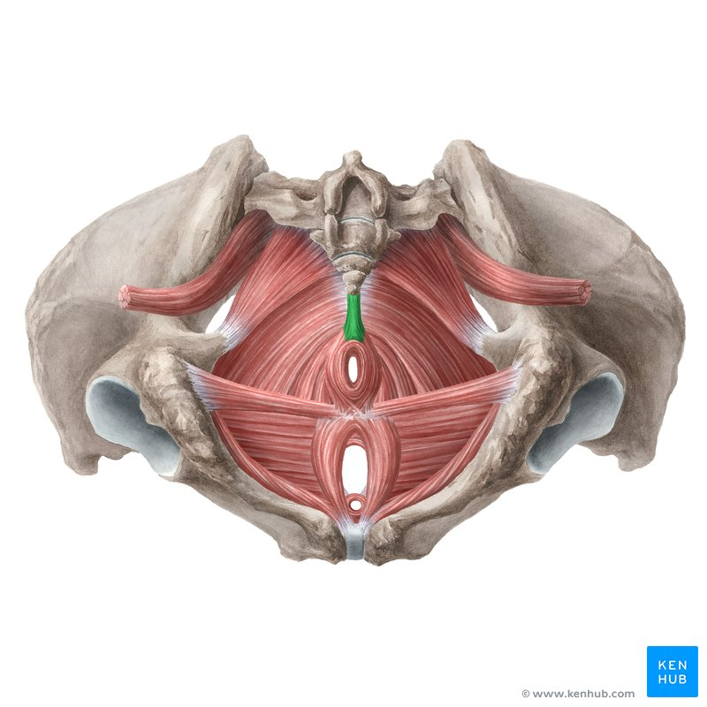

Slide 12
So how do we work it?
Check out NHS Highland youtube video “your pelvic floor”…
Your pelvic floor – YouTube
Tips:
*Do not hold your breath whilst exercising the muscles.
*Try in a variety of positions but usually lying or sitting is easier than standing.
*If symptomatic aim for 30 reps a day of both long hold and quick contractions. Symptoms usually reduce/resolve within 3 months. IF NOT THEN PLEASE SEEK HELP.

Slide 13
When shouldn’t I do pelvic floor exercises?
If it causes pain to contract the muscles…..if should NEVER be sore.
If you are unsure if you are doing them right…best to get checked out by a pelvic health physiotherapist if so.

Slide 14
How can I check I am doing it right?
Look (use a mirror) – the area of skin (perineum) between the vaginal and anus should draw upwards when contracting
Feel – gently insert a thumb or finger inside the vagina and should feel a gentle squeeze of the muscles as you contract
During sex – sometimes your partner may feel them working (not always reliable!!)
On the loo – can you stop mid flow during a pee? If so this is your pelvic floor working. We do not recommend you do this regularly as it can interfere with your natural reflexes which can prevent you emptying the bladder fully.

Slide 15
Where can I access pelvic floor physios?
The pelvic health specialist physiotherapists in NHS Highland use a self referral system. Please phone your local physio department for more info or ask for a referral form from the GP surgery.
Outwith NHS Highland it is worth checking out the “squeezy” directory for a list of physiotherapist in your area…
https://www.squeezyapp.com/directory/

Slide 16
What does a pelvic health physiotherapy appointment involve?
Initial consult – may be by telephone (30 – 60 mins)
Questions about…
General health ● Diet / fluid intake
Obstetric history ● Bowel habits
Gynae history ● Sexual function
Mental health
Bladder symptoms

Slide 17
What does the physical examination involve?
Examining your general movements and posture
Abdominal exam
External pelvic exam
Internal pelvic exam – vaginal, anal or both
Urinalysis – you can bring a urine sample with you
Important points
Informed consent throughout - your pace, no speculum, chaperone offered
PPE as per public health covid guidelines – gloves, mask (visor)

Slide 18
Anything else?
We may ask you to fill out some questionnaires and charts to fully assess your bladder and bowel habits.
Following assessment we formulate a individual treatment plan tailored to our findings.
We will organise onward referral to other health professions if needed.
You will be given the opportunity to ask questions at any point and we will always be there to listen.

